Slide 1
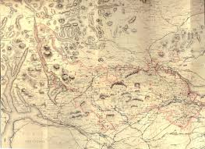
Maps and Symbols

Slide 2
Inhabited Building

Slide 3
Campground

Slide 4
Primary Road

Slide 5
Marsh Land

Slide 6
Cemetery – Small, Large

Slide 7
Saddle

Slide 8
Uninhabited Building

Slide 9
Depression

Slide 10
School and Church

Slide 11
Open Area

Slide 12
Wooded Area

Slide 13
Valley

Slide 14
unimproved road

Slide 15
Bridge

Slide 16
Perennial Stream and intermittent stream

Slide 17
Unimproved Road

Slide 18
Gravel Pit

Slide 19
Quarry

Slide 20
Tanks

Slide 21
Power Lines

Slide 22
Index Contour & Intermediate Contours

Slide 23
Well or Spring

Slide 24
Trail

Slide 25
Railroad Single & Double Track
Single
Double

Slide 26
Mine Tunnel

Slide 27
Peaks
Or

Slide 28
Ridge Line

