Slide 1
Animal Damage
By Mr. Babcock

Slide 2
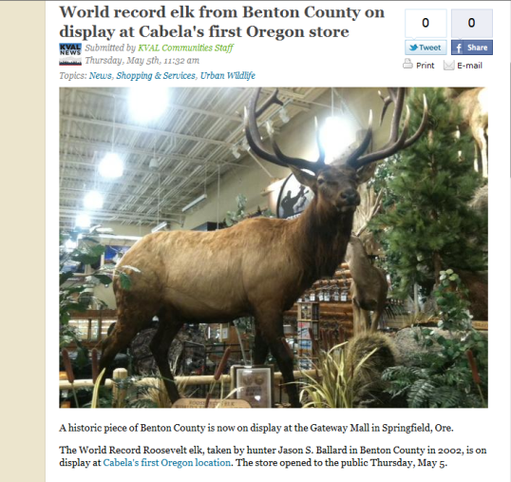
Damage/Land Preference Tags

Slide 3
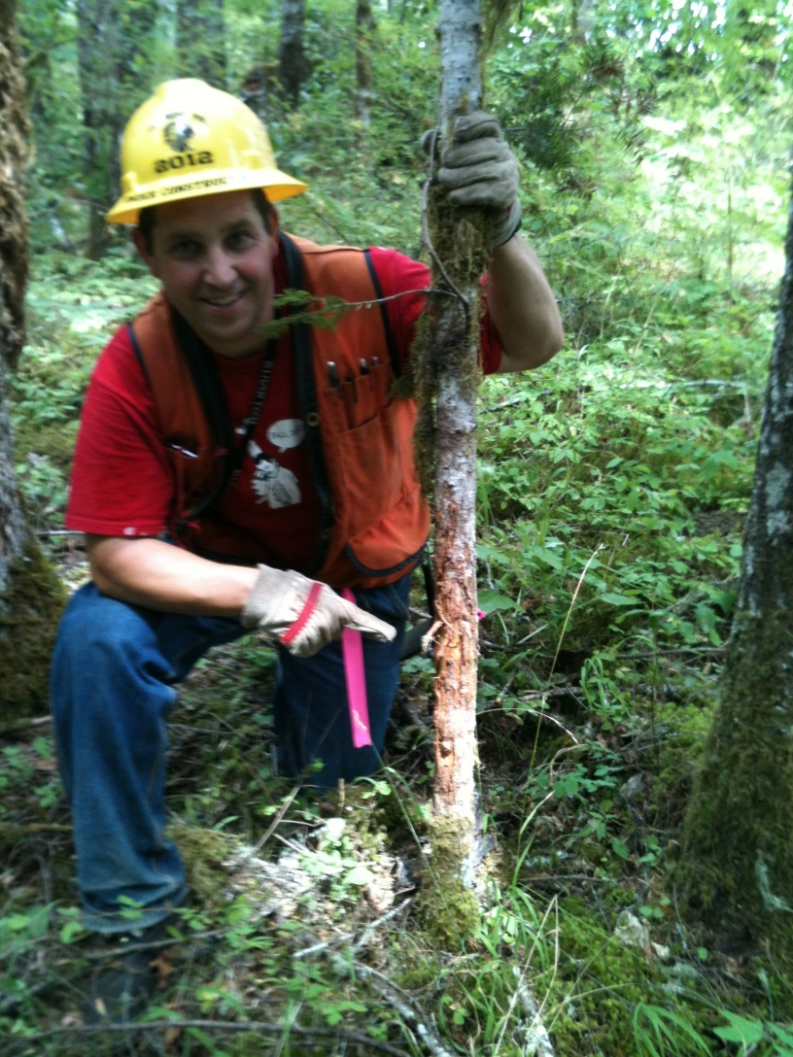
Buck Rub Starker Forests
How old is the tree?

Slide 4
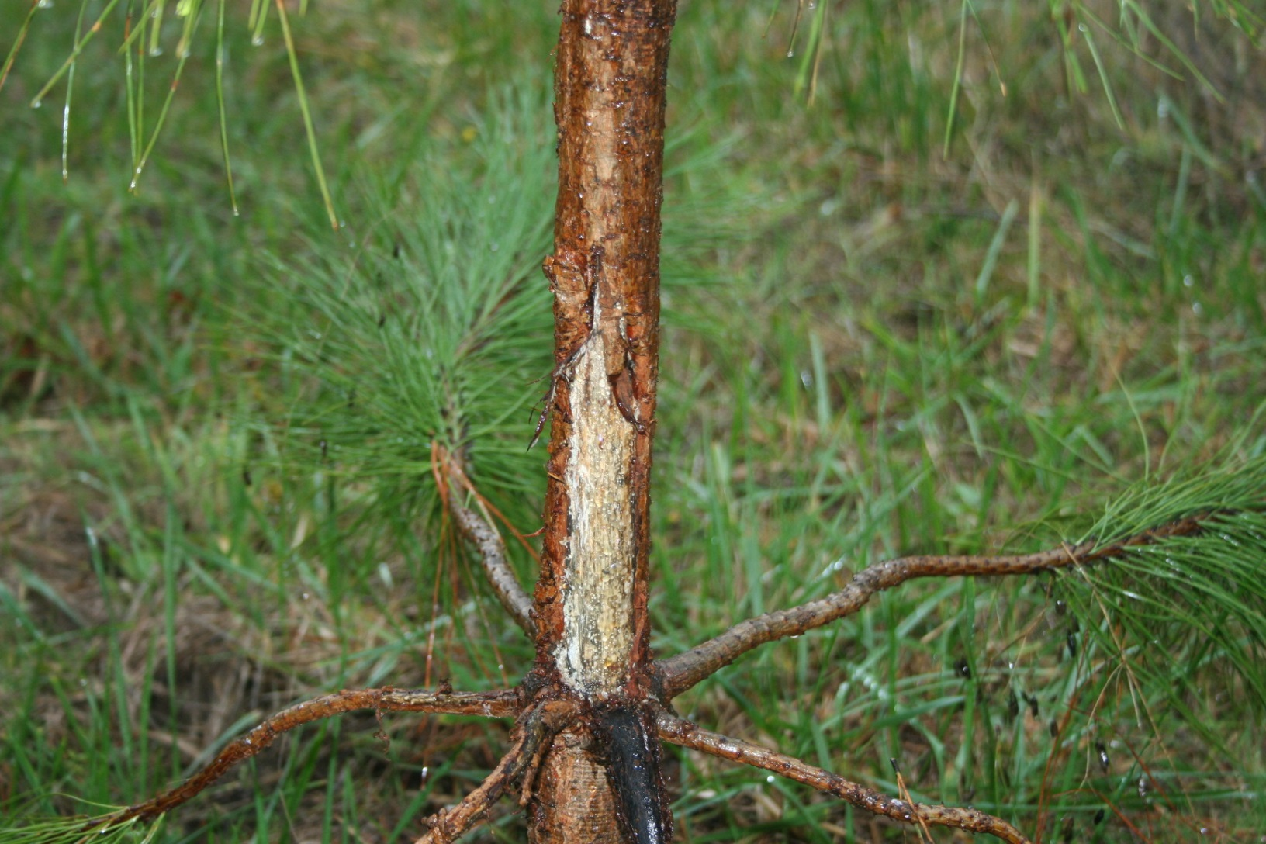
Buck Rub Downing Forest
What species of tree?

Slide 5
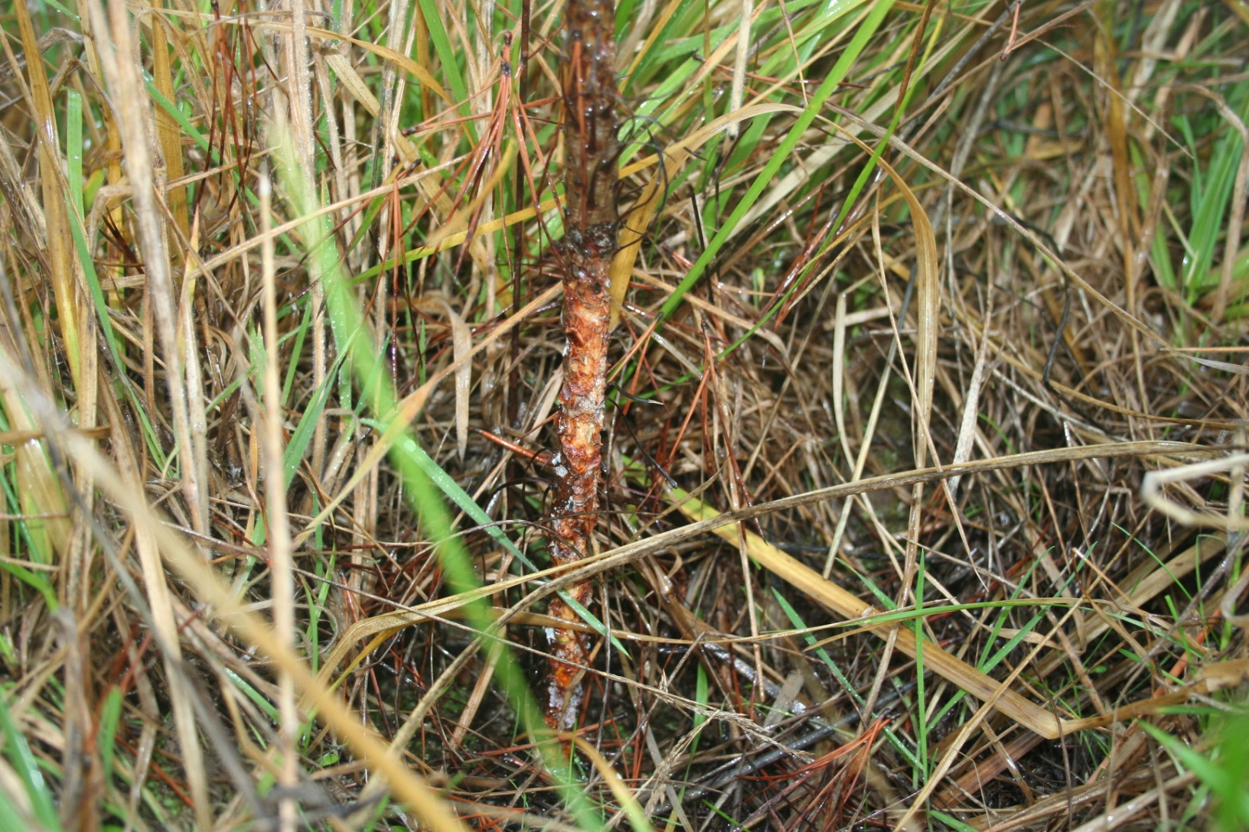
What animal did this?

Slide 6
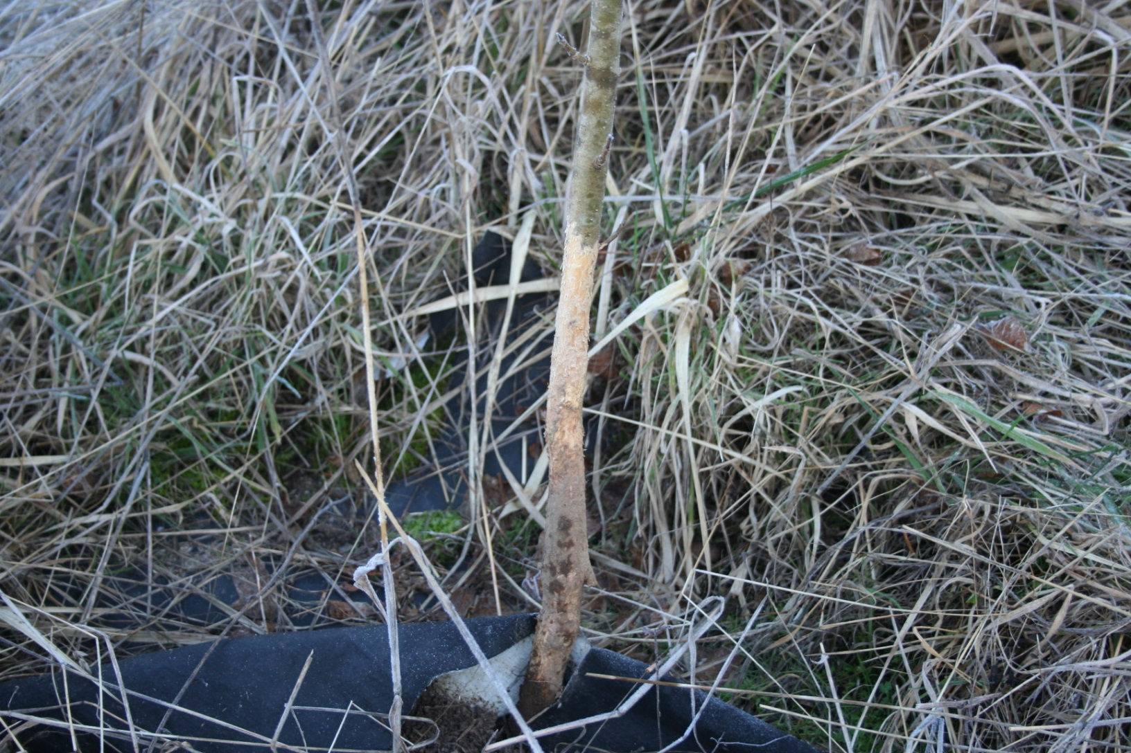
How does this impact the tree?

Slide 7
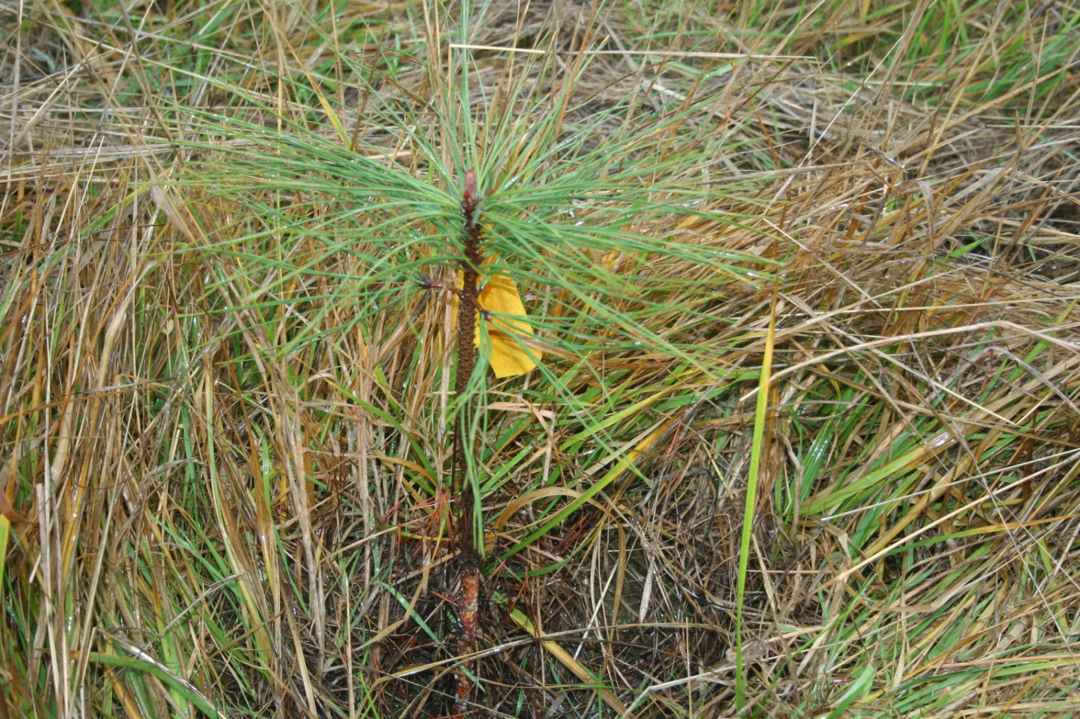
What could be done to prevent this animal damage?

Slide 8
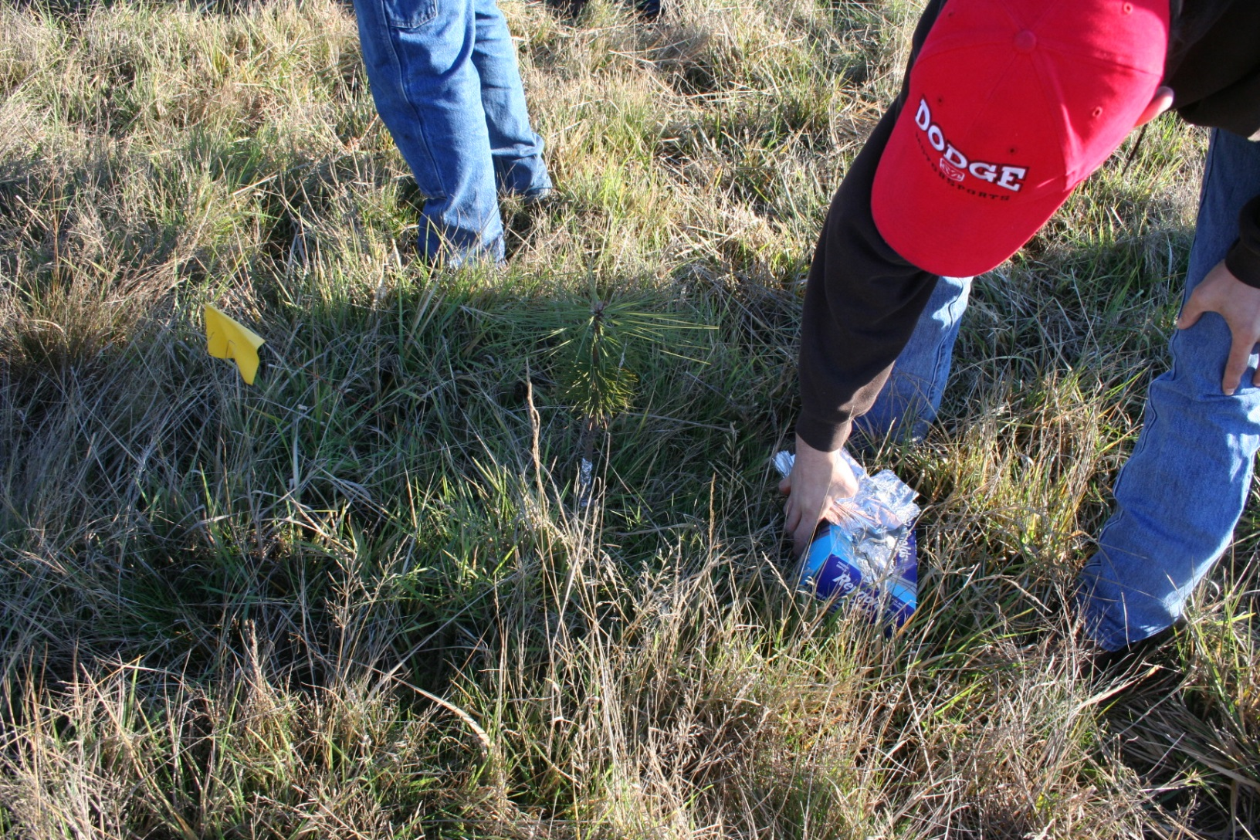
Foil

Slide 9
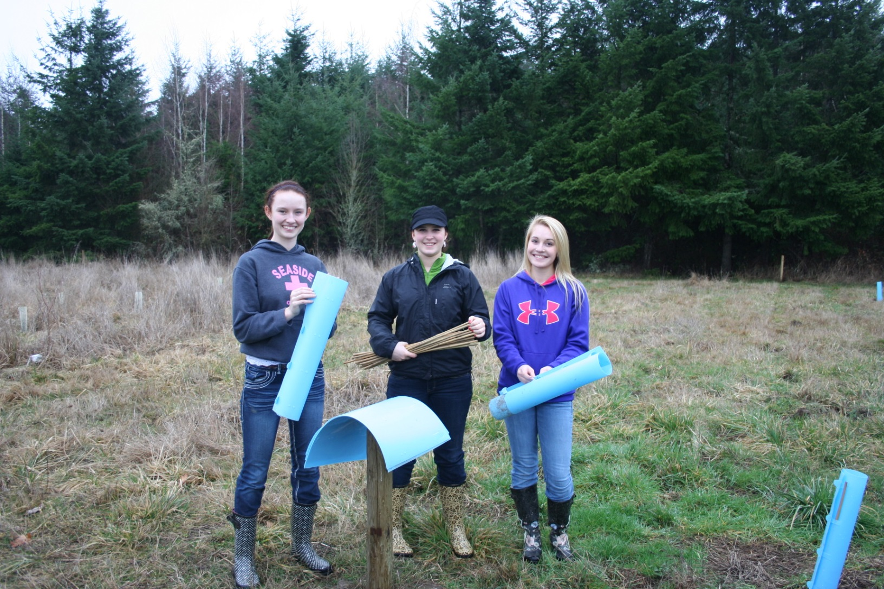

Slide 10
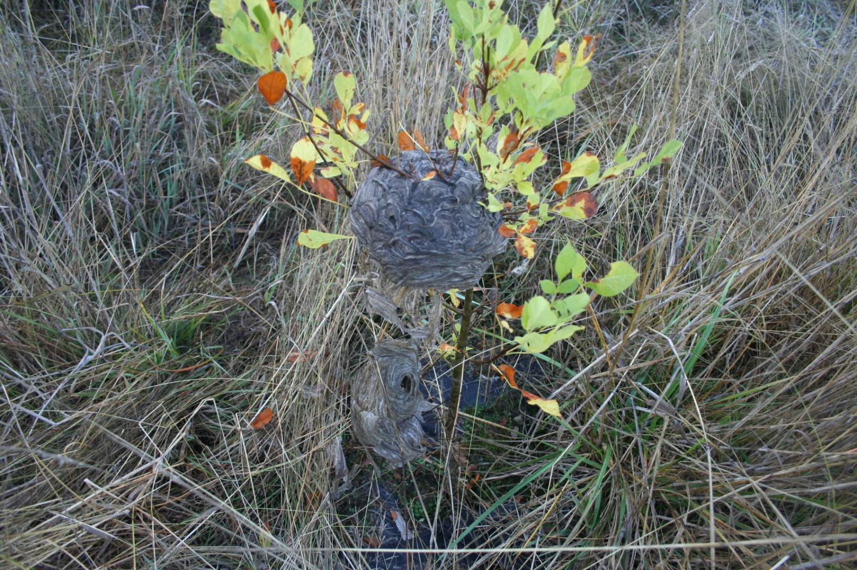
Is this animal damage?

Slide 11
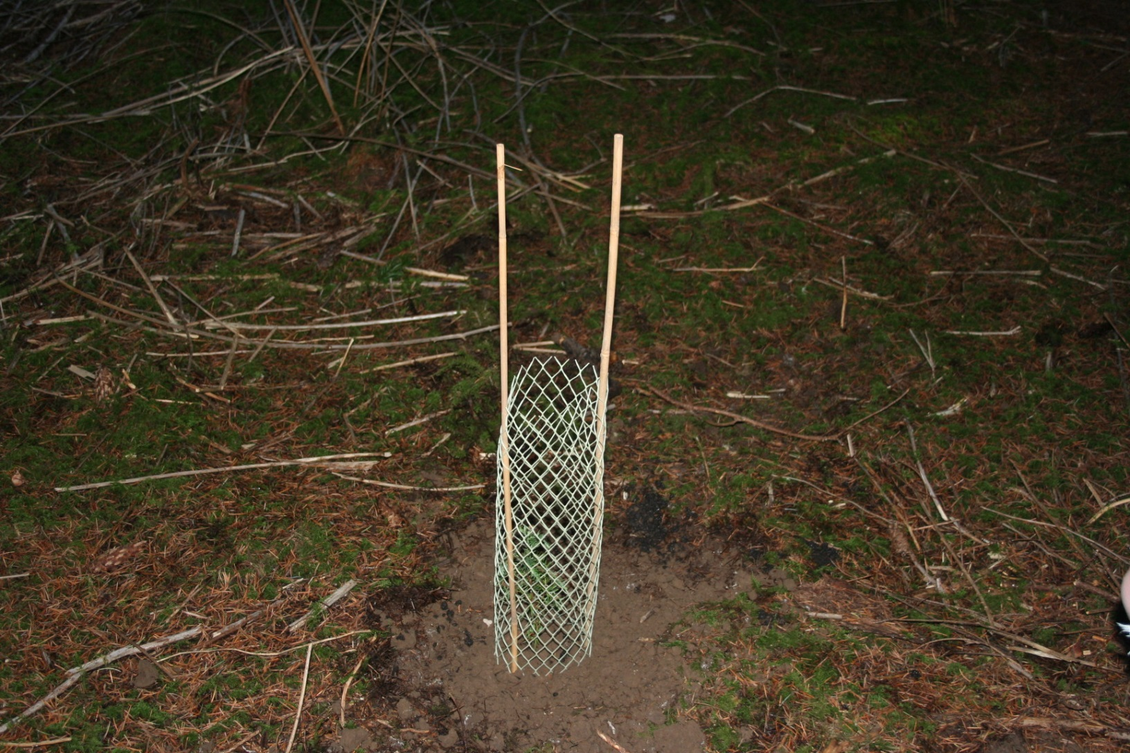
Protection from Deer/Elk Brows
What species is like candy to Deer/Elk?

